Slide 1
You Need A Budget Provider
Participants:
Vaibhav Singal

Slide 2
You Need A Budget (YNAB)
What is webMethods CloudStreams Provider for YNAB?
You Need a Budget, or YNAB, is a popular paid budgeting app. While some budgeting apps only show people what they've already spent, You Need a Budget focuses on zero-based budgeting. The app teaches you to put all your money to use -- including using your money for expenses, paying off debt, and saving extra money.
YNAB offers an API which is REST based, uses the JSON data format and is secured with HTTPS. You can use it to build a personal application to interact with your own budget or build an application that any other YNABer can authorize and use. API resources require a valid access token for authentication. There are two ways to obtain access tokens: Personal Access Tokens and OAuth Applications.
OAuth has been used to configure authentication for this Connector build.

Slide 3
Use Cases Covered
4 workflows and 3 flow services have been created for the demo. These cover 4 use cases in total as mentioned below:
Get a List of Budgets for a User
Create new transaction(s) within the budget
Update multiple transactions using a combination of workflow and flow service (updates all transactions with a single API call)
Update multiple transactions using workflow only (updates transactions one by one within a loop)

Slide 4
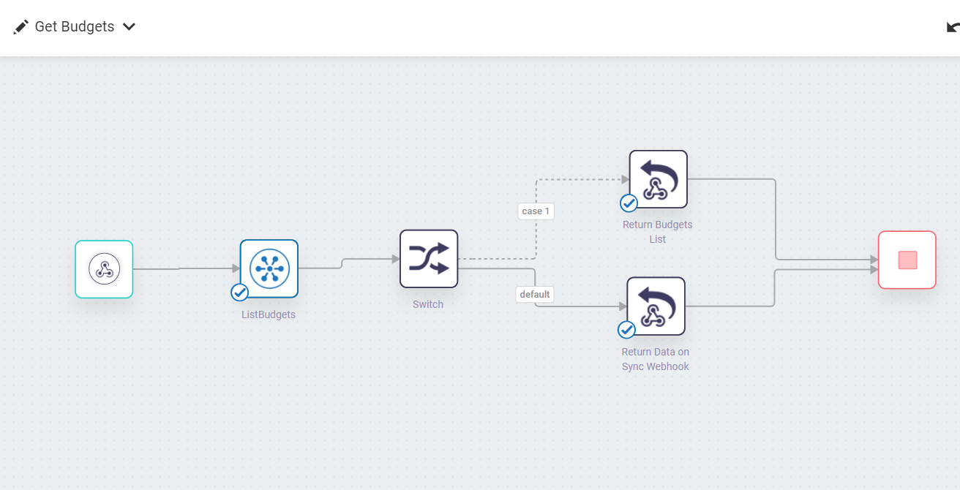
Screenshots for workflow
Get Budgets

Slide 5
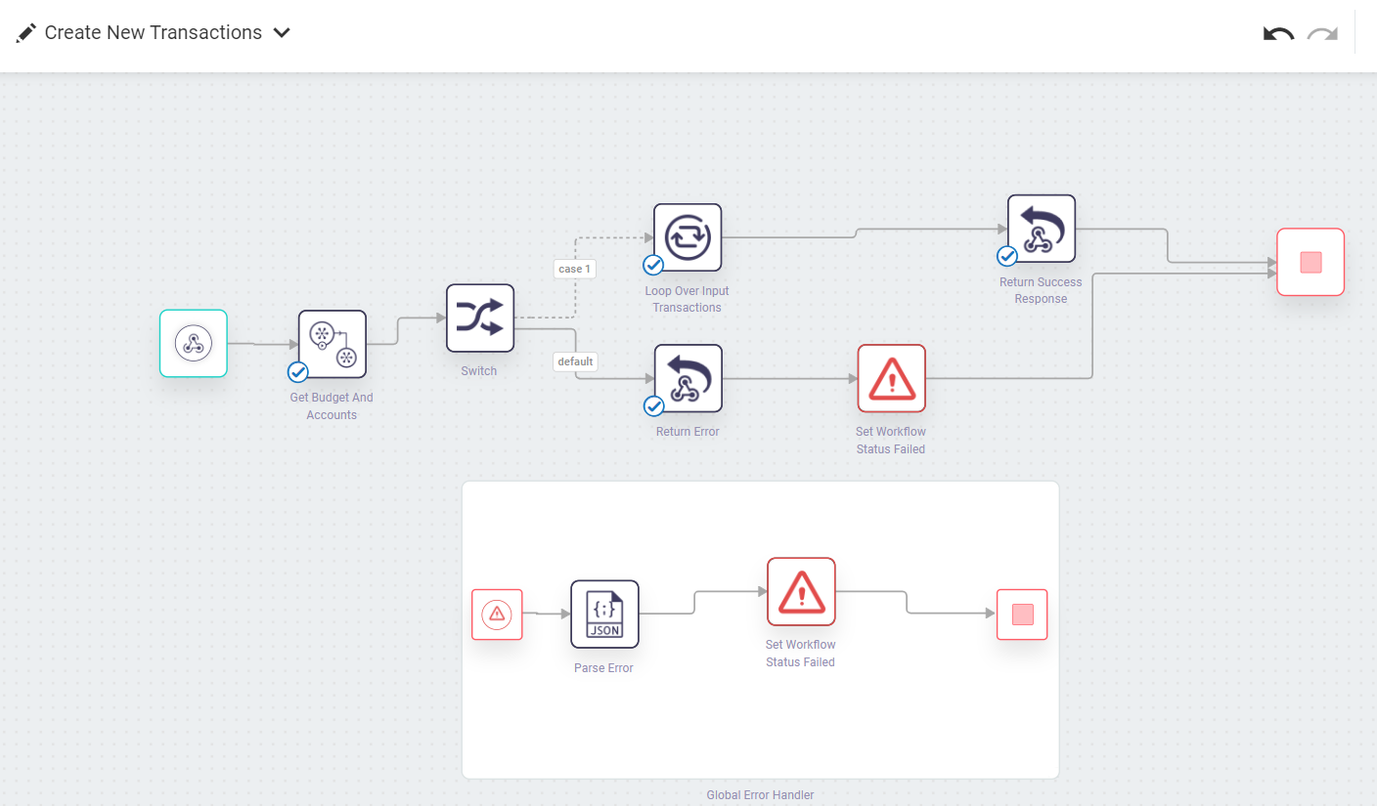
Screenshots for workflow
Create New Transactions

Slide 6
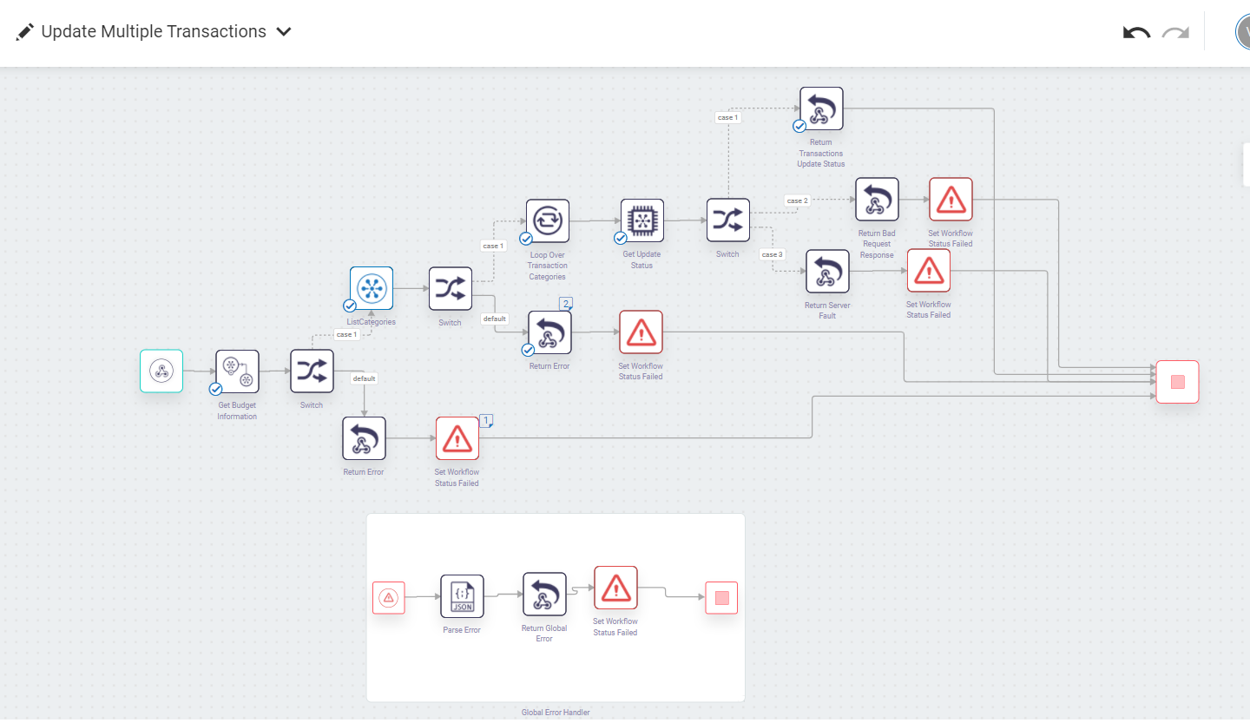
Screenshots for workflow
Update Multiple Transactions

Slide 7
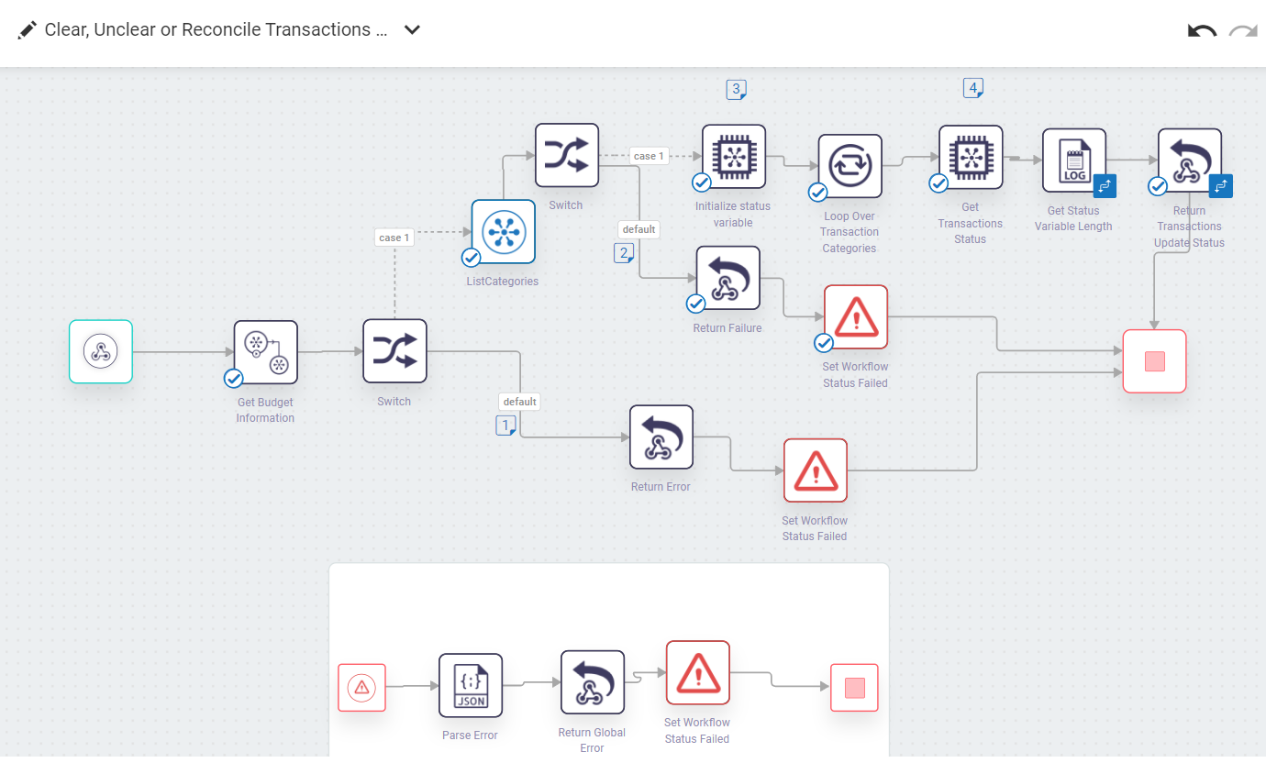
Screenshots for workflow
Update Transactions (one at a time)

